Slide 1


AZ-900
Microsoft Azure Fundamentals
Gopal Das, Instructor

Slide 2
Microsoft Azure Fundamentals
“
foundational level knowledge_
of cloud services
and how those services are provided with Microsoft Azure ”

Slide 3
Microsoft Azure Fundamentals
Candidates with
non-technical backgrounds
Candidates with a technical background who have a need to validate their foundational level knowledge around cloud services

Slide 4
Microsoft Azure Fundamentals
Describe cloud concepts
Describe Azure architecture and services
Describe Azure management and governance

Slide 5

Be Prepared!
This course will completely prepare you to pass the AZ-900 exam.

Slide 6
Taking the exam is optional, of course.
This course will give you a solid foundation in cloud concepts and Microsoft Azure.

Slide 7

What is the Cloud?

Slide 8

There is no spoon.
“The cloud” is just someone else’s computer.

Slide 9

What makes Cloud Computing special?
The ability to rent computing resources - on demand

Slide 10

Computing Resources…
Windows and Linux Servers
Unlimited File Storage
Databases
Message Queues
Content Delivery Network
Batch Processing Jobs

Slide 11


1,000+ different Azure services

Slide 12
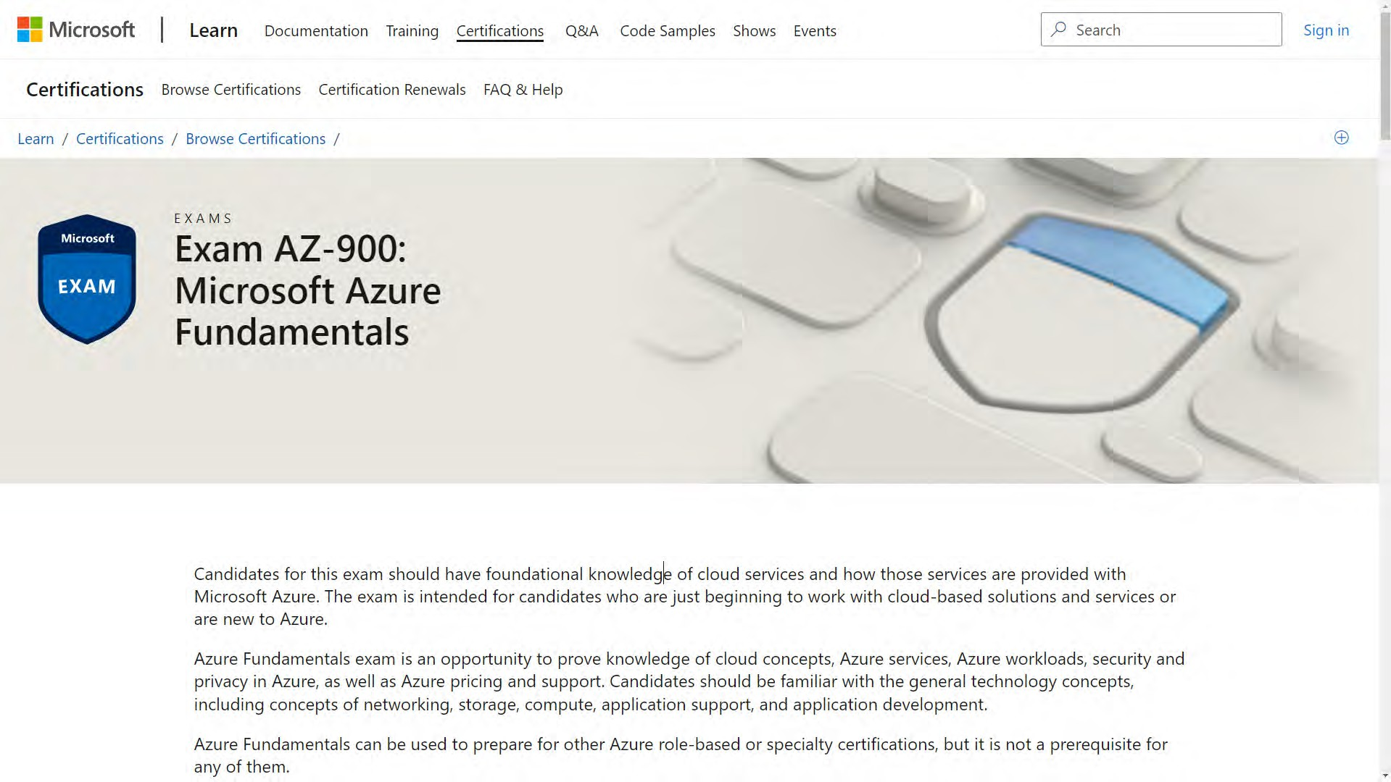

Slide 13
Free study resources within this course:
Free PDF Study Guide
Download the slides and MP3 audio if you like to study offline
50 question practice test
Located in the last section of the course.

Slide 14
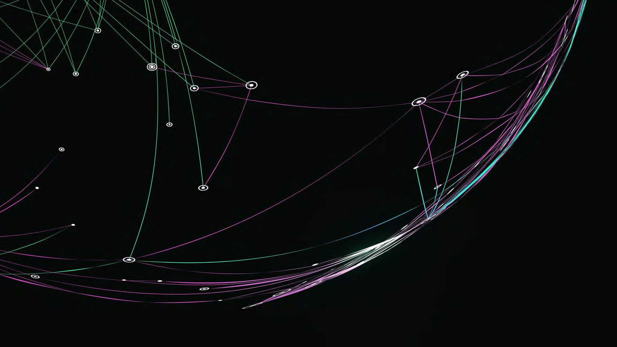
Describe Cloud Concepts (25-30%)

Slide 15
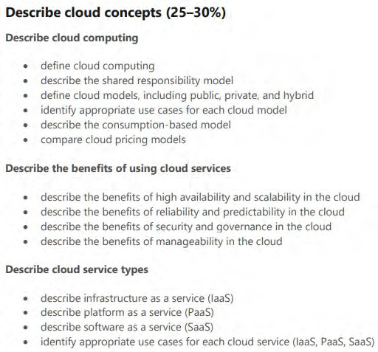
2022

Slide 16
Describe Cloud Computing

Slide 17
What is the Cloud?

Slide 18
There is no spoon.
“The cloud” is just someone else’s computer.

Slide 19
What makes Cloud Computing special?
The ability to rent computing resources - on demand

Slide 20
Computing Resources…
Windows and Linux Servers
Unlimited File Storage
Databases
Message Queues
Content Delivery Network
Batch Processing Jobs

Slide 21
1,000+ different Azure services

Slide 22
Shared Responsibility Model

Slide 23
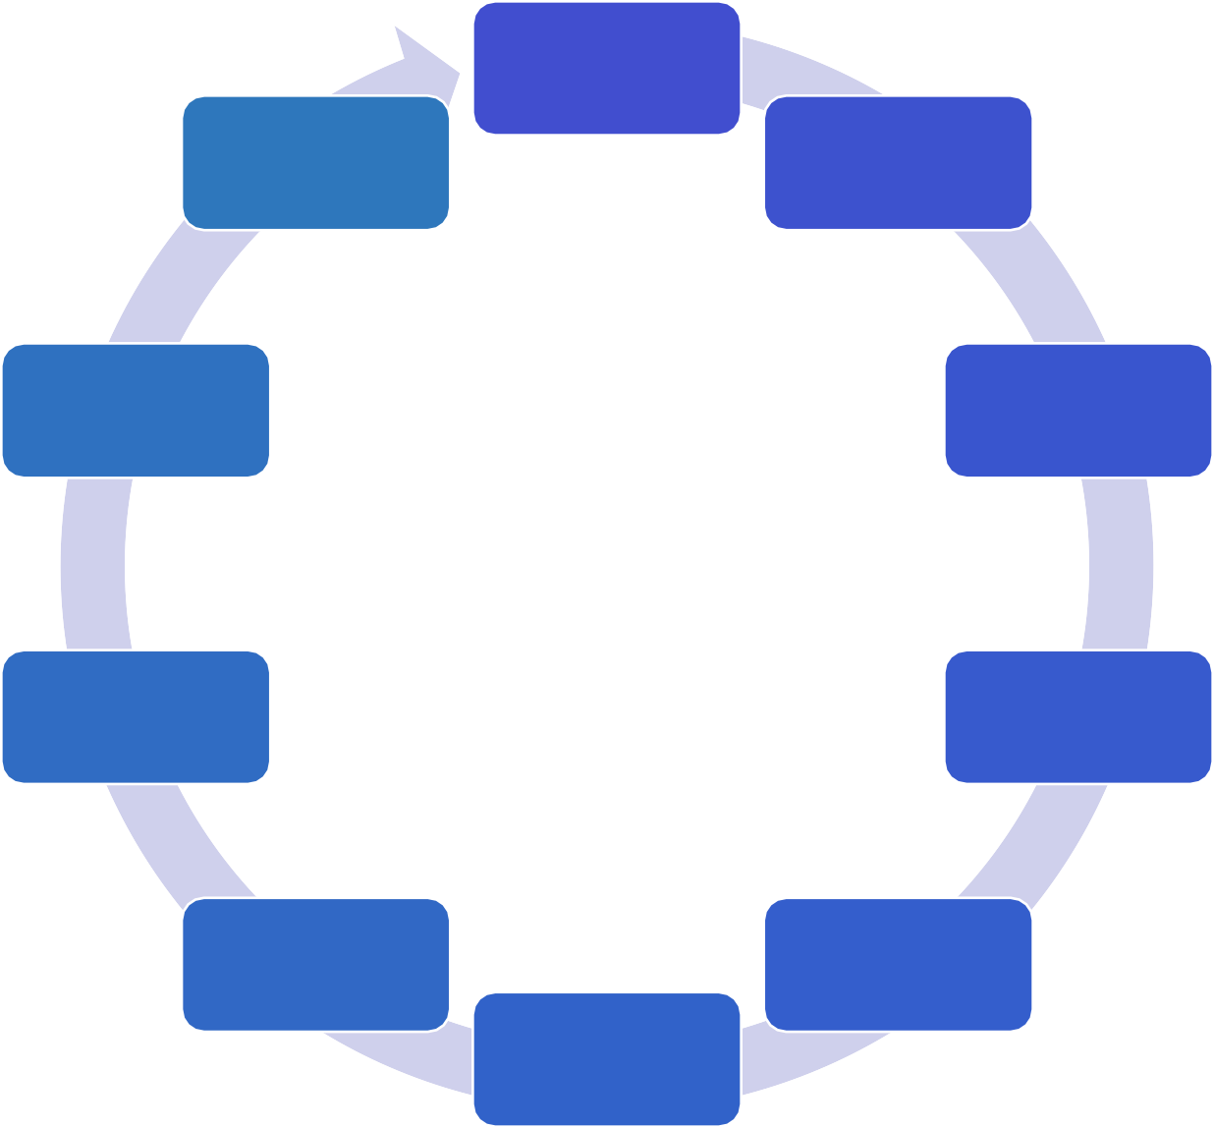
On Premises Responsibility:
Building security
Data
Physical network security
Physical computer security
Devices
All You!
User accounts
Operating system patches
Authentication platform
Network and Firewall settings
Application settings

Slide 24

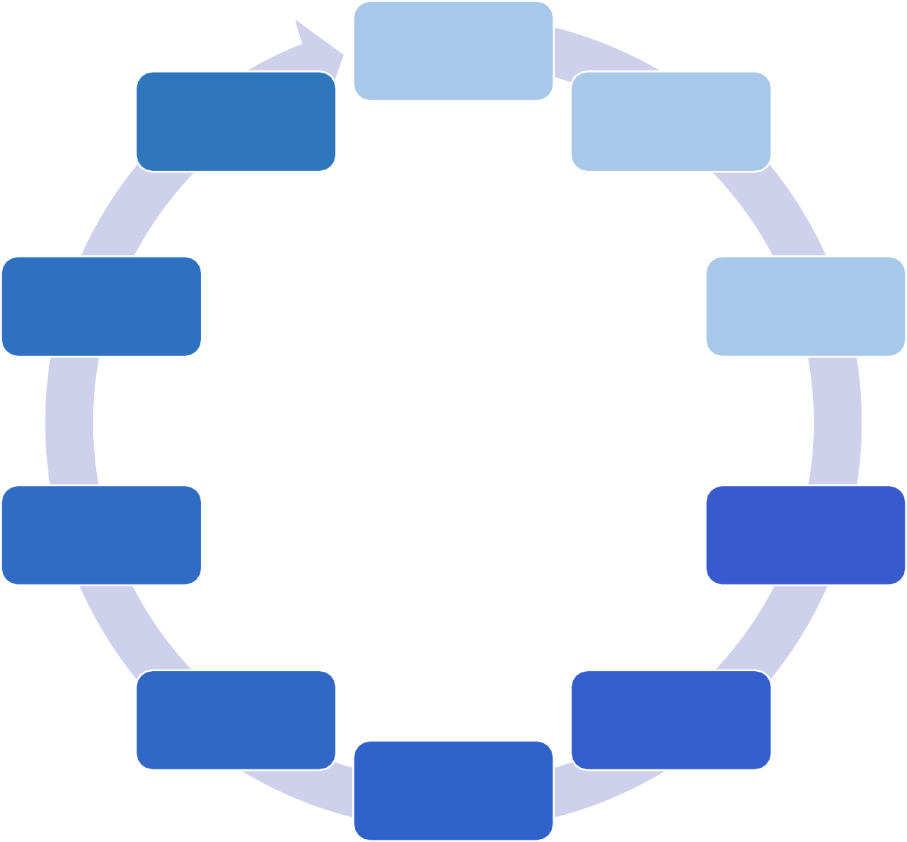





Cloud
Virtual Machine Responsibility:
Building security
Data
Physical network security
Physical computer security
Devices
Mixed
User accounts
Operating system patches
Authentication platform
Network and Firewall settings
Application settings

Slide 25
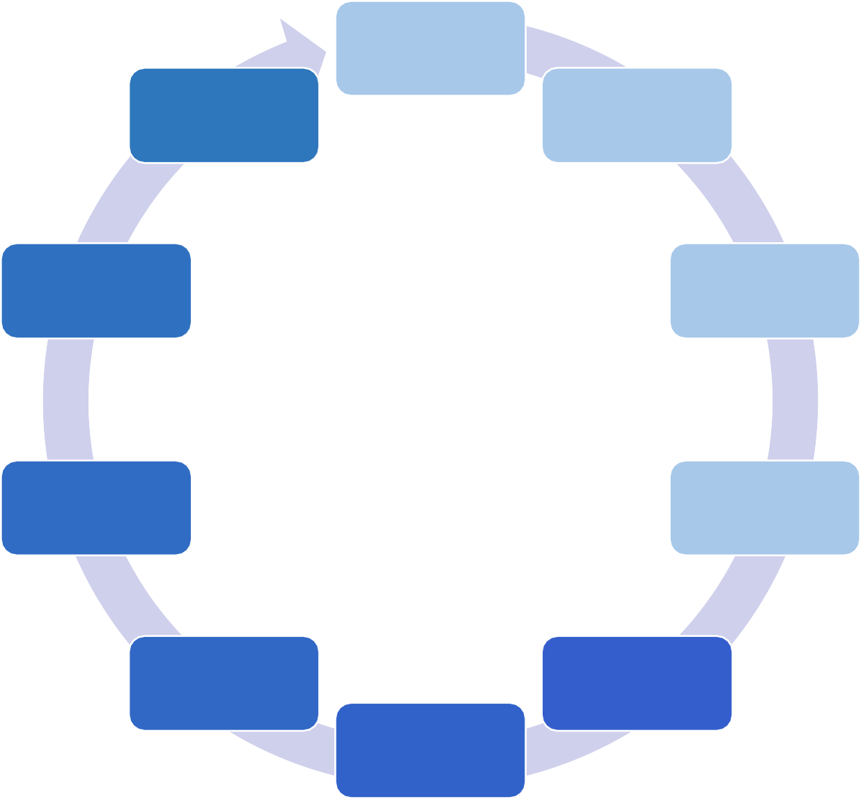

Cloud
App Service Responsibility:
Building security
Data
Physical network security
Physical computer security
Devices
Mixed/ Shared
User accounts
Operating system patches
Authentication platform
Network and Firewall settings
Application settings

Slide 26
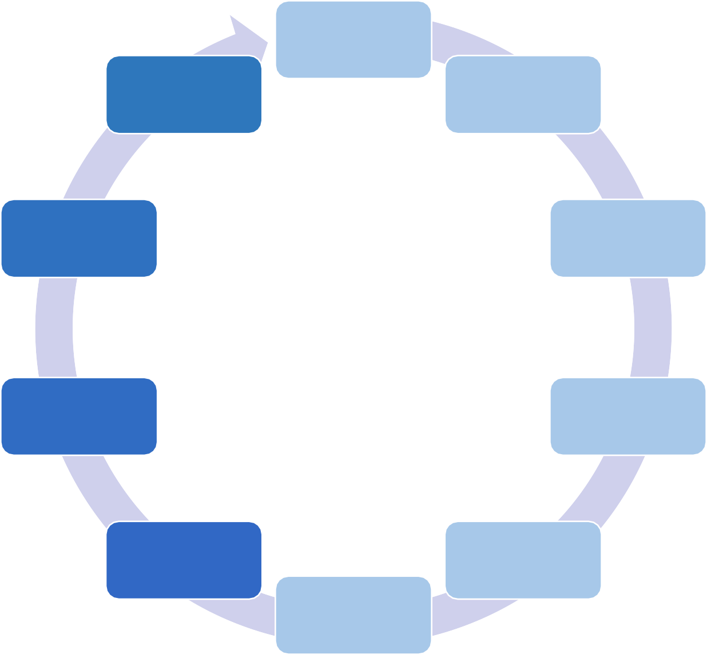

Cloud SaaS
Responsibility:
Building security
Data
Physical network security
Physical computer security
Devices
Mixed/ Shared
User accounts
Operating system patches
Authentication platform
Network and Firewall settings
Application settings

Slide 27
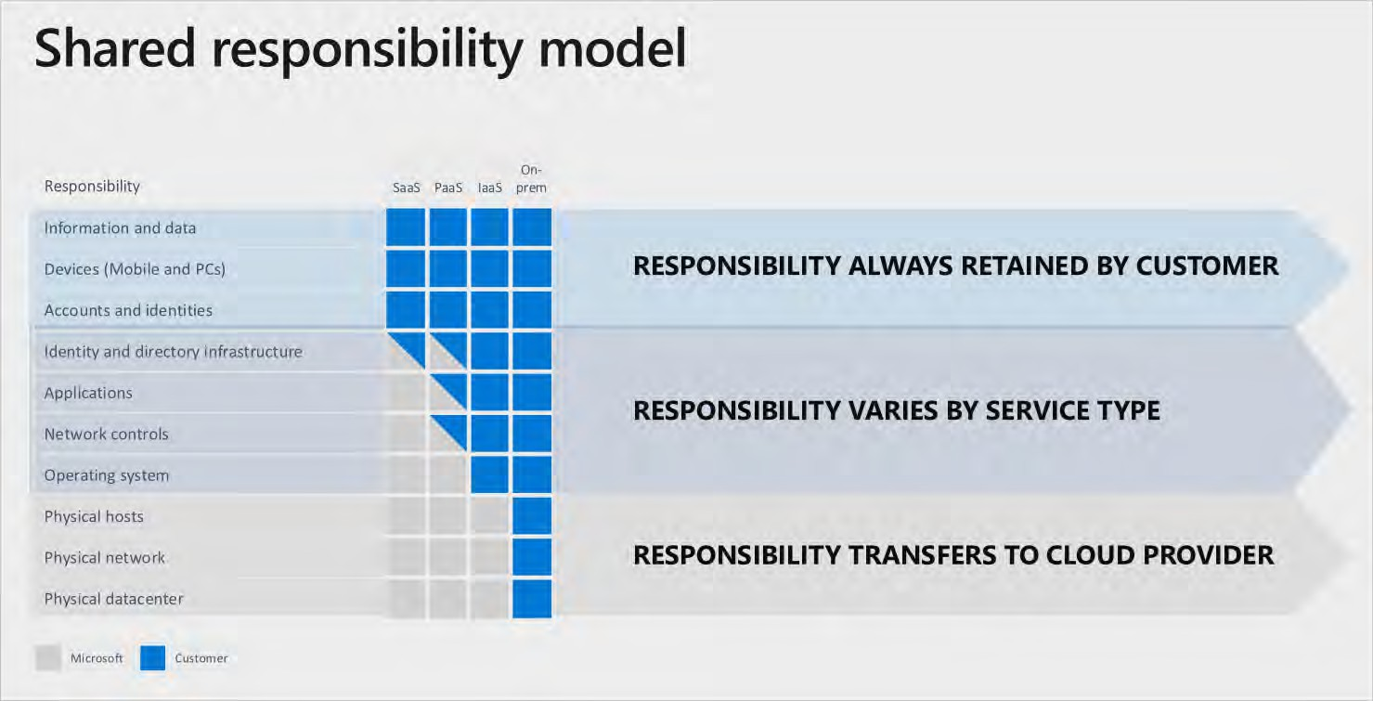

Slide 28
AZ-900
Microsoft Azure Fundamentals
Gopal Das, Instructor
, softwarearchitect.ca… get the course for these slides at: http://sjd.ca/az900

Slide 29
Public cloud

Slide 30
“The public cloud is defined as computing services offered by third- party providers over the public Internet, making them available to anyone who wants to use or purchase them.”

Slide 31
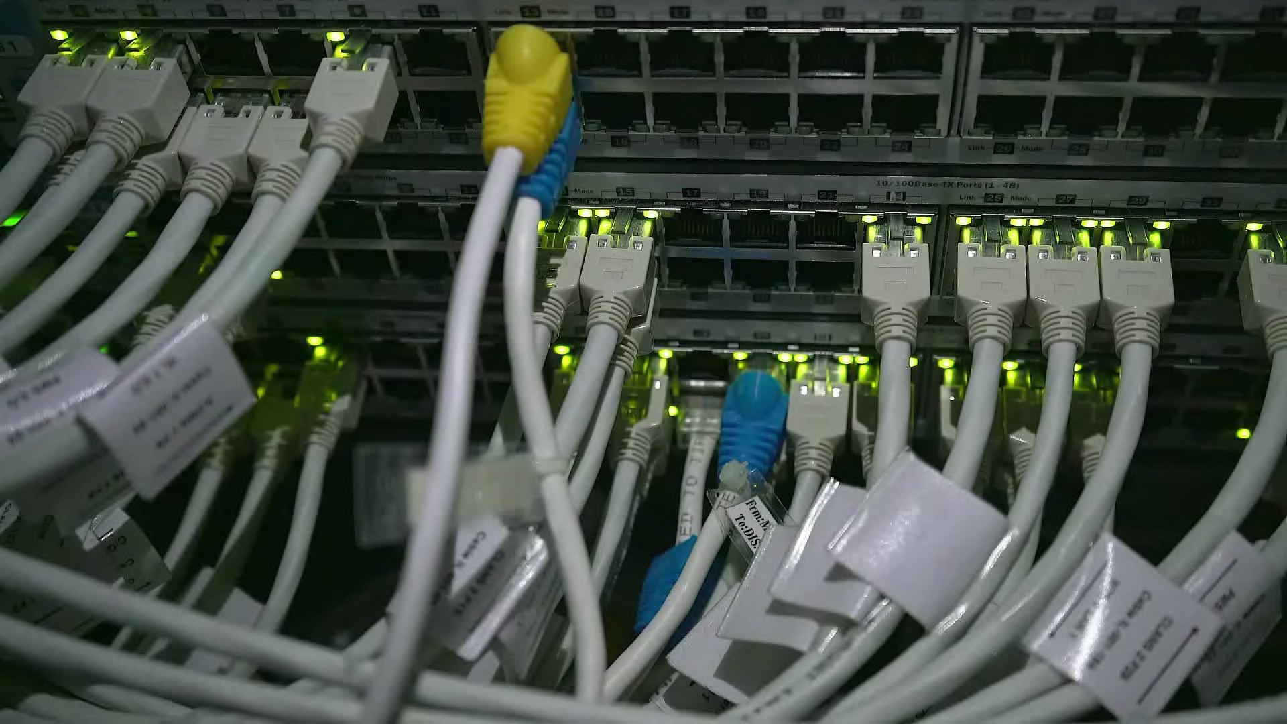

Azure owns the hardware, on their network and infrastructure

Slide 32
Private cloud

Slide 33
“The private cloud is defined as computing services offered either over the Internet or a private internal network and only to select users instead of the general public.”

Slide 34
“A hybrid cloud… is a computing environment that combines a private cloud with a public cloud.”

Slide 35
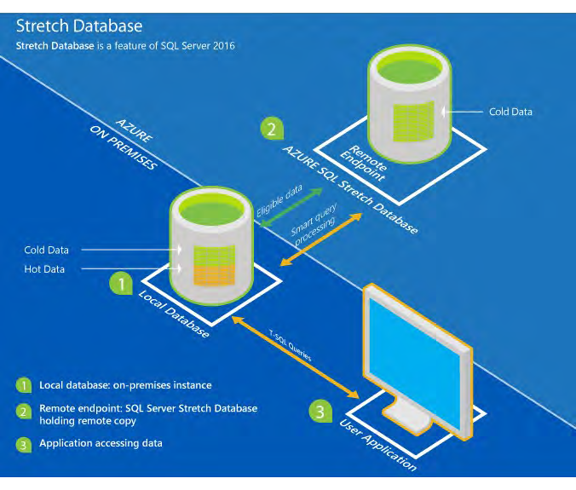
Combination of public and private clouds; scale private infrastructure to the cloud

Slide 36
AZ-900
Microsoft Azure Fundamentals
Gopal Das, Instructor
, softwarearchitect.ca… get the course for these slides at: http://sjd.ca/az900

Slide 37

Can Be Considered a Downside to Cloud Computing
Difficult to predict your monthly bill
Difficult to understand in advance what a service will really cost
Possibility for big savings but you lose predictability

Slide 38




Factors Affecting VM
Pricing
Geographical Region
Operating System SKU / License
Instance Size
Disk Type / Size
Bandwidth
Backup Storage
Reservation / Savings Plan
Support Agreement

Slide 39



Factors Affecting Cosmos DB Pricing
API Choice
Region / Regions
Standard Model
/ Serverless
Number of Operations per Second
Consumed Storage
Optional Dedicated Gateway
Backup Storage

Slide 40
Free Services
55+ free services that can be used as part of your solution
Some paid services have free tiers
Some have limits

Slide 41
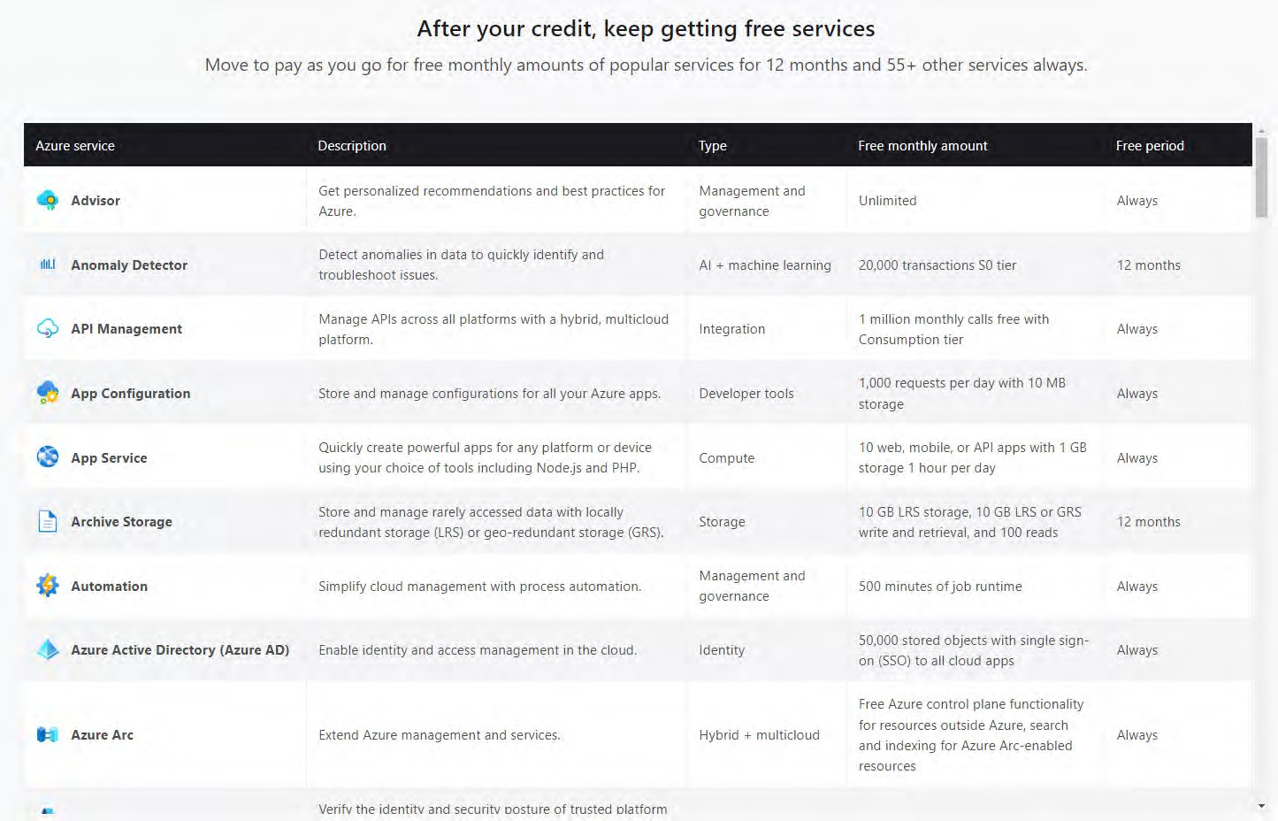
55+ Free Services

Slide 42

Pay for Time
Some services charge by time used
Stop using the service to stop the charges
i.e. Virtual Machine Instances

Slide 43

Pay for GB
Usually you pay for any data storage used
Fairly cheap - $0.02 per GB per month
Also pay for network traffic to/from other regions, or to the Internet

Slide 44

Pay for Operations
In addition to paying for storage space, and bandwidth, you can also be charged per operation
Operations are read, write, list, delete
Pay per message, pay per query to a database, etc.
Usually very cheap per operation

Slide 45
2022

Slide 46
High Availability

Slide 47
High Availability (HA)
Ability of a system to remain operational to users
during
planned
or
unplanned
outages

Slide 48
Planned Outages
Operating System security patches
Application updates
Hardware replacement
Migrating to a new hosting provider

Slide 49
Unplanned Outages
Hardware failure
Network disruptions
Power outages
Natural disasters
Cyber attacks
Software bugs
Poor scaling / architecture design

Slide 50
Methods to Mitigate Planned Outages
Gradual deployment strategy
1-10-100-etc
What all application you can migrate.
Windows 2000 2003 server
Custom os secure the network and do the migration
In cloud you will always have the latest os.
Testing and monitoring of deployment
Easy rollback plan
Small deployments
Frequent deployments
Automation CICD pipeline. Azure has an Inbuilt CD pipeline Tool. Azure Devops

Slide 51
Methods to Mitigate Unplanned Outages
Every single core component has redundancy
Use Azure’s built-in features for availability
Availability Sets
Availability Zones
Cross-Region Load Balancing / Front Door
Constant health monitoring / probes
Automation

Slide 52
Methods to Mitigate Unplanned Outages
Strong security practices
Be geographically distributed
Have a disaster recovery plan
Test that disaster recovery plan / fire drills!
Load testing

Slide 53
High-Availability Is…
A conscious effort to avoid the obvious sources of downtime

Slide 54
AZ-900
Microsoft Azure Fundamentals
Gopal Das, Instructor
, softwarearchitect.ca… get the course for these slides at: http://sjd.ca/az900

Slide 55

Scalability

Slide 56
Scalability
The ability of a system to accommodate
increasing demand by resources as needed.
adding or removing

Slide 57
Why Is It Needed?
It allows a system to adapt to changing usage patterns and handle increased traffic without requiring changes to the application code or system design.

Slide 58
Does Traffic Fluctuate?
Some businesses have traffic that fluctuates based on time of day or day of the year
E-commerce websites have Black Friday
School registrations are busy in September
Tax systems are busy in April

Slide 59
The $1M Question…
Can you expand the capacity of a system very easily, by adding more servers?
Or will it be a massive undertaking to do that?

Slide 60
Vertical Scaling
Also called or “scaling down”
“scaling up”
Adding more resources to a single server
Increase the amount of memory, the number of CPUs
There is an upper limit to this
Azure – 96 vCPUs, 384 GB memory
(Does not improve availability)

Slide 61
Horizontal Scaling
Also called “scaling out” or “scaling in”
Adding more servers to a system
No limits to scaling
Additional complexities for load balancing
(Can improve availability)

Slide 62
Impact on System Cost
Adding more resources to a system adds to cost
Reducing resources can reduce cost
Having a scalable system allows for a system to be perfectly sized
This optimizes the cost by reducing wasted computing resources

Slide 63
App failure
Max capacity
Number of concurrent users

Slide 64


Slide 65
AZ-900
Microsoft Azure Fundamentals
Gopal Das, Instructor
, softwarearchitect.ca… get the course for these slides at: http://sjd.ca/az900

Slide 66

Elasticity

Slide 67
Elasticity
The ability of a system to
quickly and easily
scale up or down the amount of resources that a system uses in response to changing demand

Slide 68
Quickly and Easily
Has to involve some sort of automation
Often called “autoscaling” in cloud computing
The system monitors some metric (such as CPU utilization) to determine how busy a system is
Adds resources when it exceeds a limit for being busy
Remove resources when it falls below a limit for being not busy

Slide 69
Why Is It Needed?
More efficient and cost-effective use of resources
Minimizes computing “waste” – resources paid for and not used
Self-hosted systems tend to have a large percentage of “over-provisioned” resources for anticipated future growth

Slide 70
Save Here, Spend There
Also have the potential to have a maximum capacity higher than you could afford if you had a static provisioning of resources

Slide 71
capacity
User demand

Slide 73
AZ-900
Microsoft Azure Fundamentals
Gopal Das, Instructor
, softwarearchitect.ca… get the course for these slides at: http://sjd.ca/az900

Slide 74

Reliability

Slide 75
All Three Relating to High Quality Service
Availability
Reliability
Predictability

Slide 76
Reminder: Availability
The ability of a system to be accessible and
usable by when they need it
users

Slide 77
Reliability
•
degree of accuracy
The ability of a system to | perform its intended
function without interruption |  | and with a high

Slide 78
Availability vs Reliability
A system can be
highly available to users
In that it responds instantly to every request
However, don’t look behind the curtain!
The system itself might be
highly unreliable
What use is a calculator that can answer every question with the wrong answer?
Or an app that loses your data sometimes randomly?

Slide 79
Availability vs Reliability
Availability is an appearance to end users
Reliability is the underlying truth

Slide 80
Reliability

Slide 81
Reliability
How dependable a system is
The ability of a system to perform its intended function without interruption and with a high degree of accuracy

Slide 82
Why Is It Needed?
You have to trust that your cloud provider is doing everything it can to make its platform reliable
This includes transparency during service issues

Slide 83
How Is It Achieved?
Auto-scaling
Multi-region deployments
Data backup and replication
Health probes and self-healing

Slide 85
AZ-900
Microsoft Azure Fundamentals
Gopal Das, Instructor
, softwarearchitect.ca… get the course for these slides at: http://sjd.ca/az900

Slide 86

Predictability

Slide 87
Predictability
The ability to forecast and control the performance and behavior of a system
Includes the ability to predict future costs

Slide 88
Why Is It Needed?
Predictability gives you the that the
confidence
system will continue to perform at the expected level in the future
And of course that you won’t get a crazy bill unexpectedly

Slide 89
How Is It Achieved?
Autoscaling
Load balancing
Different instance types, sizes, pricing tiers
Cost management tools
API
Pricing calculators

Slide 91
AZ-900
Microsoft Azure Fundamentals
Gopal Das, Instructor
, softwarearchitect.ca… get the course for these slides at: http://sjd.ca/az900

Slide 92

Security

Slide 93
Security is a full-time job

Slide 94
Security
Cloud providers are obviously massive targets for hackers, and so they rightly spend a lot of time, money and effort on platform security
Cloud providers go through security audits and compliance certifications
And provide customers (you) the tools they need to enable and monitor security with their own applications/data

Slide 95
Why Is It Needed?
Security is a in IT
fundamental challenge
You want confidence that your cloud provider cannot easily be defeated by hackers and those with malicious intent

Slide 96
How Is It Achieved?
Industry standard compliance certifications
Microsoft Security Response Center (MSRC)
Always-on DDoS
Azure Policy & Blueprint
Role based access control (RBAC)
Azure Active Directory
Always up-to-date platform services
Update management
Encryption by default
Dozens of security services like firewall

Slide 98
AZ-900
Microsoft Azure Fundamentals
Gopal Das, Instructor
, softwarearchitect.ca… get the course for these slides at: http://sjd.ca/az900

Slide 99
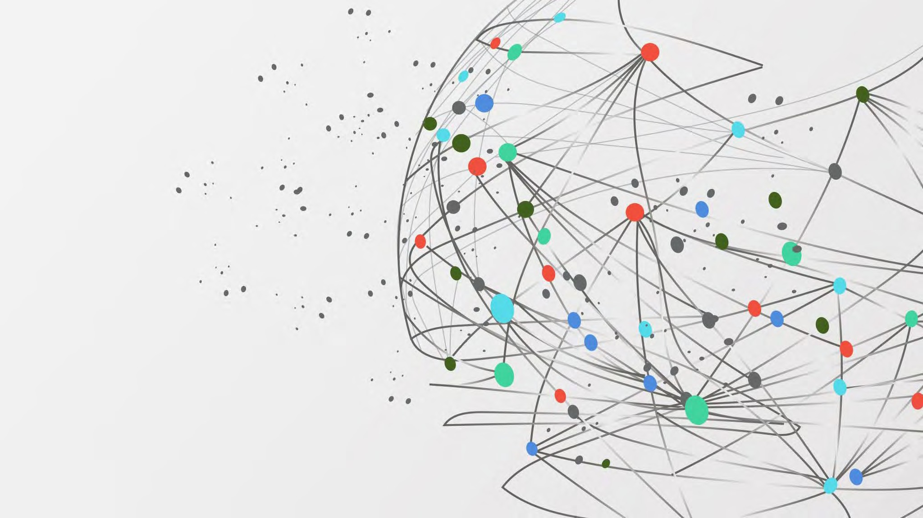
Governance

Slide 100
Governance
How your organization does business
The process of defining, implementing, and monitoring a framework of policies that guides an organization's cloud operations

Slide 101
Why Is It Needed?
Your company wants to ensure it’s policies are followed in the cloud
Includes basic auditing and reporting, as well as enforcement
You want to be compliant with industry standards such as HIPPA or PCC or GDPR

Slide 102
How Is It Achieved?
Azure Policy & Blueprint
Management groups
Custom roles
Soft delete
Guides and best practices such as Cloud Adoption Framework

Slide 104
AZ-900
Microsoft Azure Fundamentals
Gopal Das, Instructor
, softwarearchitect.ca… get the course for these slides at: http://sjd.ca/az900

Slide 105

Manageability

Slide 106
Manageability
Management of the cloud
Management in the cloud

Slide 107
Management of the Cloud
Templates
Automation
Scaling
Monitoring and alerts
Self-healing

Slide 108
Management in the Cloud
Web portal
Command line interface and scripts
APIs
PowerShell

Slide 109
Why Is It Needed?
How easy it is to work with your applications in the cloud impacts cost, performance, security and other priorities
Different cloud vendors are going to be easier or harder to work with

Slide 110
How Is It Achieved?
Azure Portal, CLI, PowerShell, Cloud Shell, REST APIs, and other programmatic methods
Consolidated monitoring and alerting system
Ability to use ARM templates, Bicep, Terraform, etc
Autoscaling of most types of compute resources

Slide 112
AZ-900
Microsoft Azure Fundamentals
Gopal Das, Instructor
, softwarearchitect.ca… get the course for these slides at: http://sjd.ca/az900

Slide 113
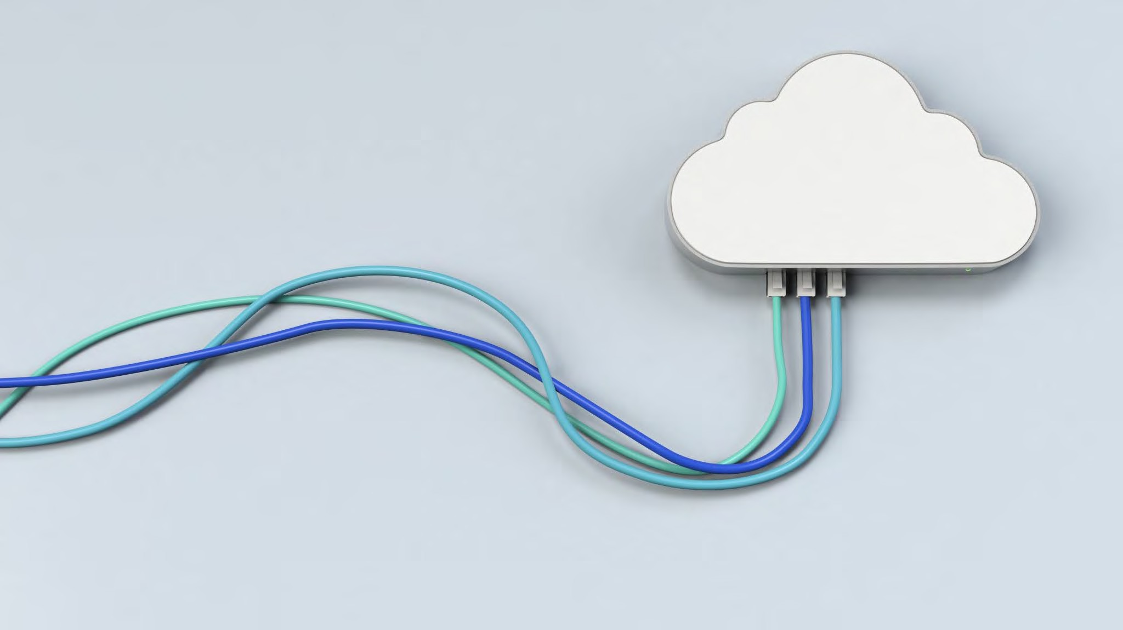
Cloud Service Types

Slide 114
Cloud Service Types
Infrastructure as a Service (IaaS)
Platform as a Service (PaaS)
Software as a Service (SaaS)

Slide 115
“As a Service”
You can rent it for a short time, if you wish
No commitment, if you wish
Pay for what you use (time, GB, or other)
Cloud provider takes care of buying, developing, and maintaining it

Slide 116
Infrastructure as a Service (IaaS)
These are the essential services of technology
Computing
Storage
Networking
Generally have “real world” equivalents in your own data center
Cloud replacements of real world things

Slide 117
IaaS Computing
One example is Azure
Virtual Machines
Pay by the second
Many choices in CPU speeds, RAM, optimizations

Slide 118
IaaS Storage
•
Azure Storage
is one example of this
5 PB of storage capacity
Can handle blobs, files, queues, and tables
Can also be configured as a data lake

Slide 119
IaaS Networking
•
Virtual Networking
is an example of this
Virtual Networks don’t cost anything
There are ingress and egress bandwidth costs

Slide 120
Platform as a Service (PaaS)
Cloud service providers have an opportunity to provide more than just the “basic” infrastructure
PaaS includes a service layer on top of IaaS – computing, storage and networking
Middleware, development tools, database server, and more

Slide 121
PaaS Computing
One example is
Azure App Services
Simply upload your code and configuration to Azure, and it runs your code without needing to worry about the VM underneath
Includes scaling features, CI/CD, containers, staging and development environments, etc

Slide 122
PaaS Storage
•
Managed Storage
is an example of this
•
Azure SQL Database
is another example
Freed from worrying about the server VM itself or the hard disk itself

Slide 123
PaaS Networking
Azure Front Door is an example of this
Or Load Balancer
Or Firewall
These are software applications that perform networking tasks

Slide 124
Software as a Service (SaaS)
Cloud apps
Tools such as Office 365, OneDrive, Skype
The app is ready to be used and you simply need to set it up and use it

Slide 125
AZ-900
Microsoft Azure Fundamentals
Gopal Das, Instructor
, softwarearchitect.ca… get the course for these slides at: http://sjd.ca/az900

Slide 126
Describe Azure Architecture and Services (35-40%)

Slide 127
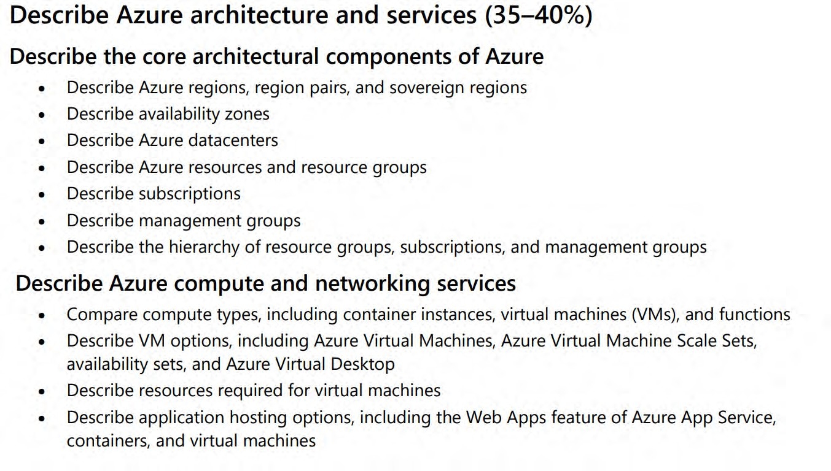
2022

Slide 128
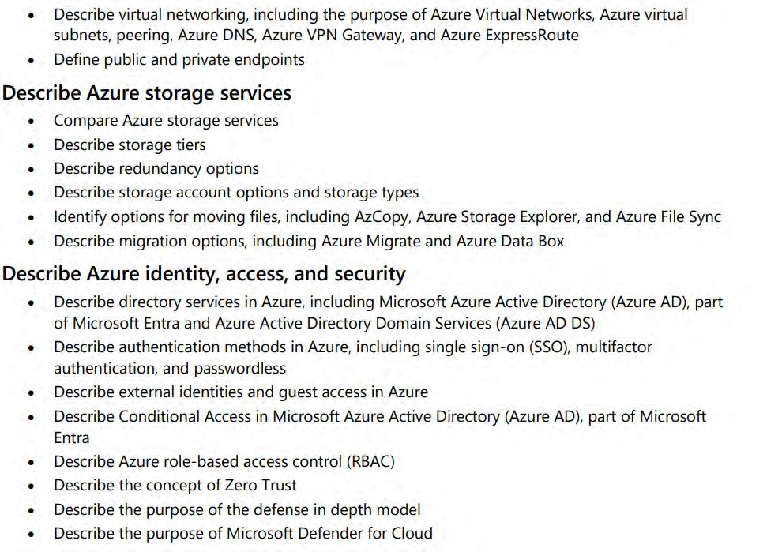

Slide 129
Core Azure Architecture

Slide 130
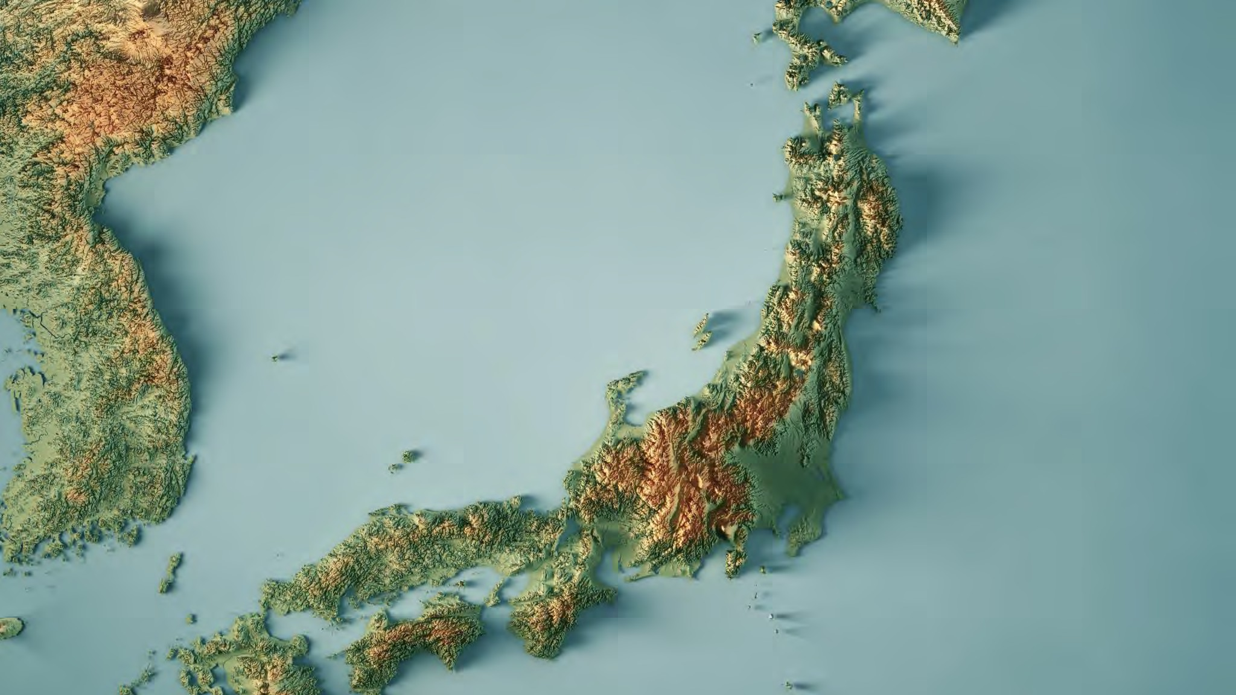
Azure Regions Region Pairs Sovereign Regions

Slide 131
Regions
Areas of the world where Azure has a
set of datacenters (minimum 3 in a set)
Not necessarily “countries” but can be
Usually each region is connected to another region to make a “region pair”
Region pairs have highest speed connections and special treatment during Azure updates

Slide 132



https://infrastructuremap.microsoft.com/explore

Slide 133
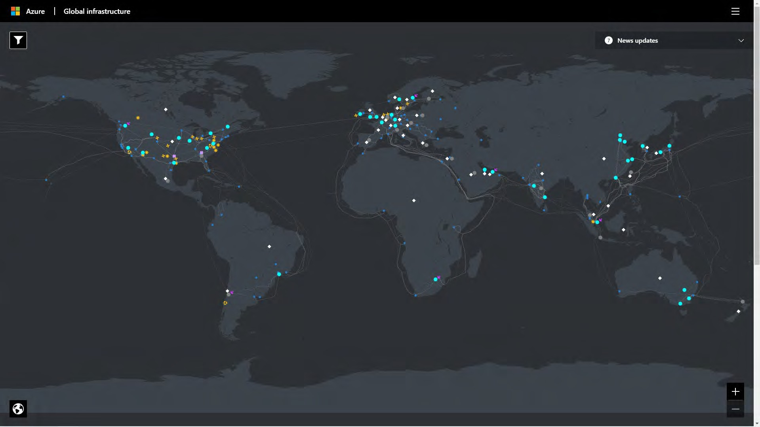

Slide 134
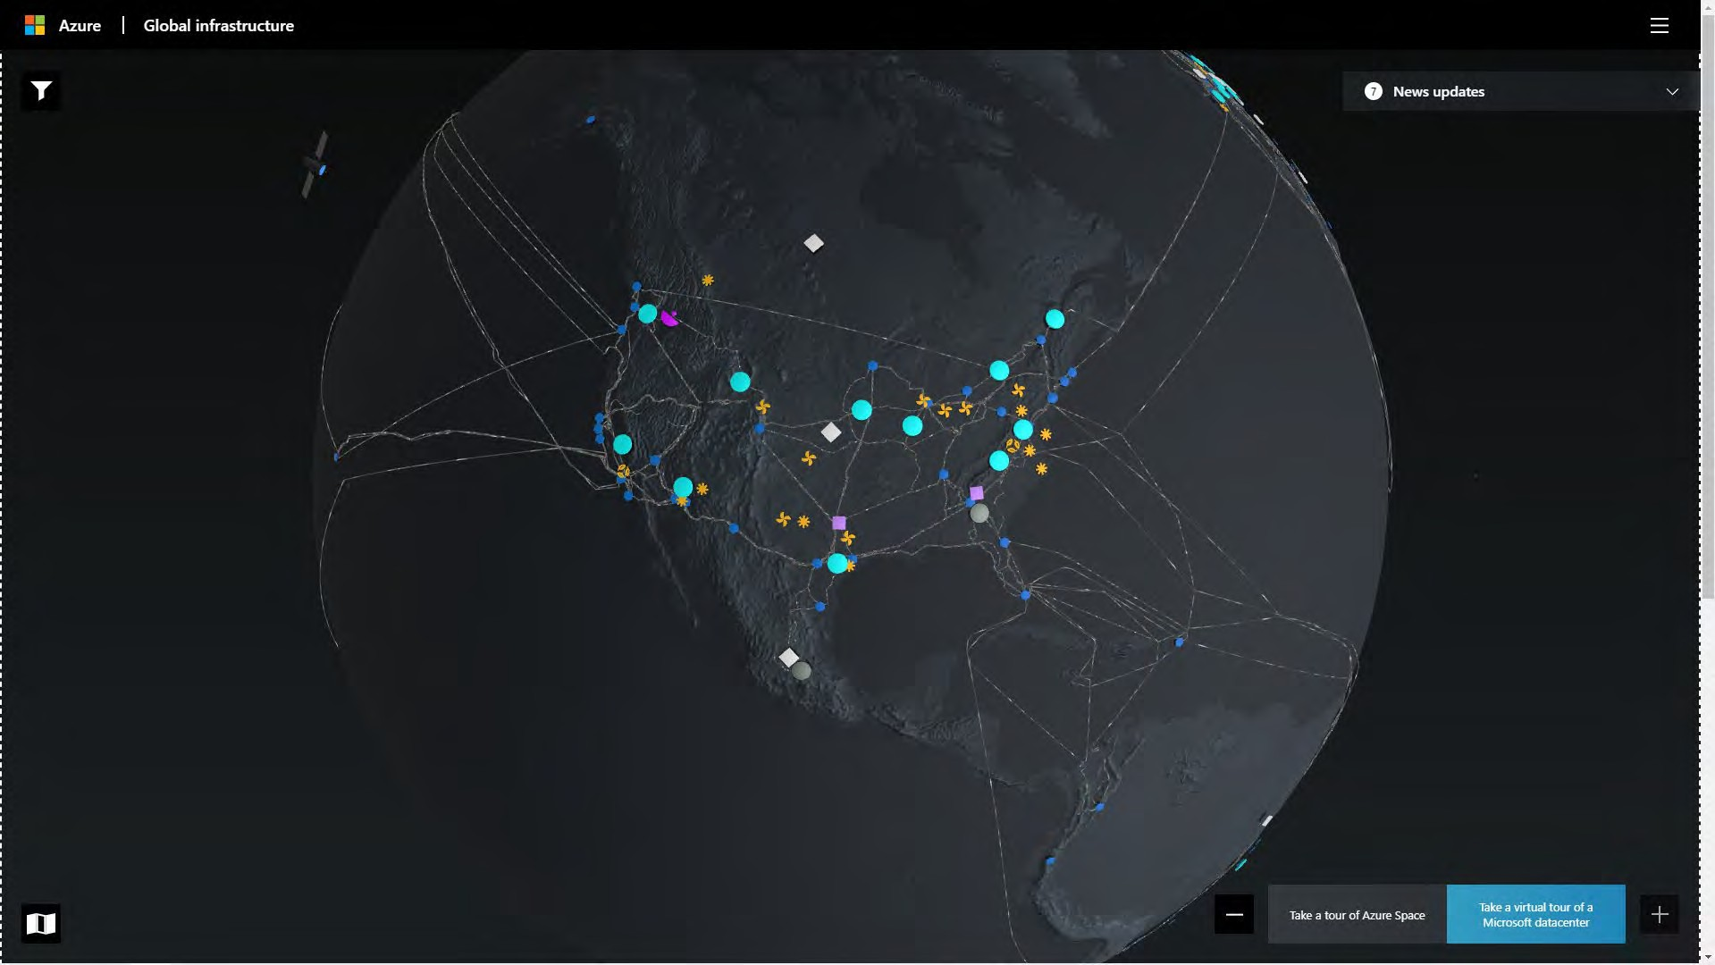

Slide 135
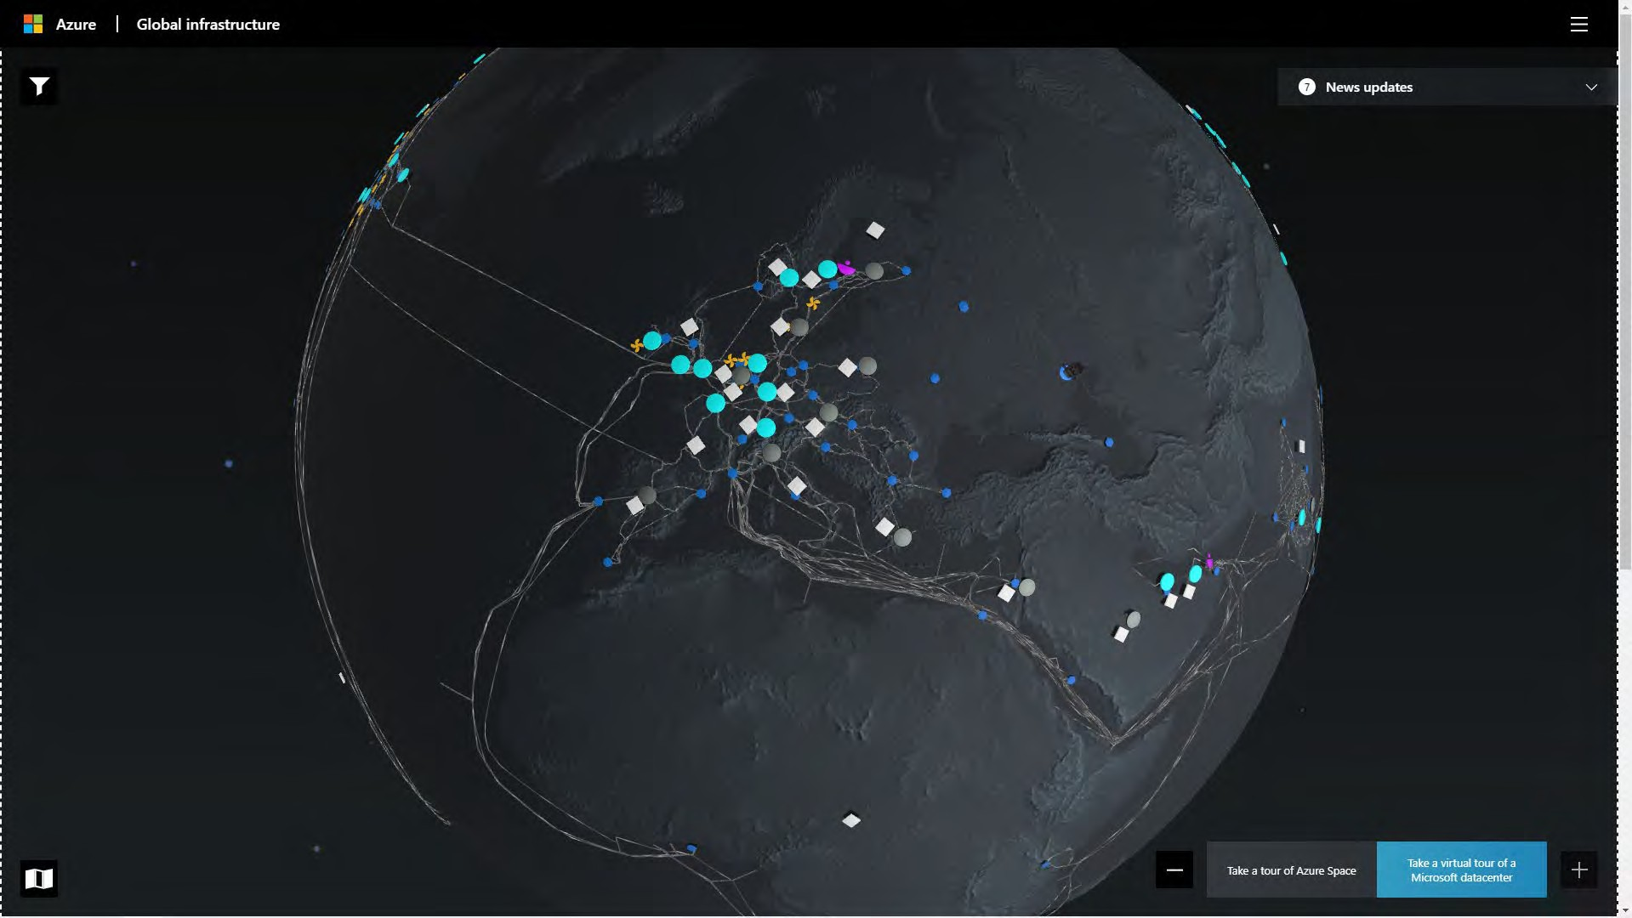

Slide 136
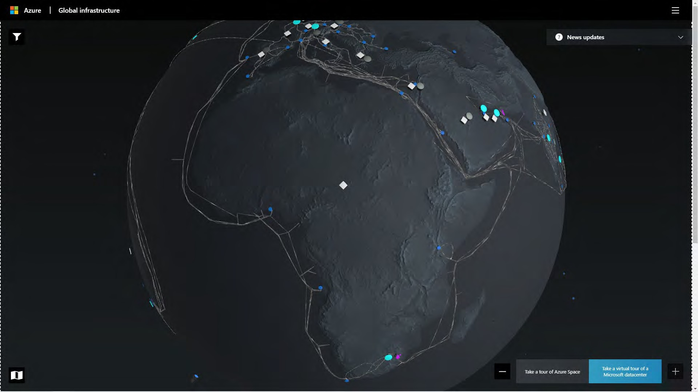

Slide 137
E.g. Canada
Canada has two regions – Canada Central and Canada East
Data stored in these regions never leaves Canada
Anyone can use these regions

Slide 138
E.g. Brazil
Brazil only has one region – Brazil South
Currently is the only region in South America, but Chile is coming online soon
Paired with South Central US (one way)
Data does leave Brazil (to the US)

Slide 139
E.g. Qatar
Qatar is the first region that does not have a pair
Does not support Geo-Redundant Storage (GRS) option
Uses Availability Zones for high availability

Slide 140
Example Pairs
Canada
Europe
USA
USA
USA
Brazil
Canada Central - Canada East North Europe - West Europe East US - West US
East US 2 - Central US
North Central US - South Central US Brazil South -> South Central US

Slide 141

When you create a resource in Azure, you have the choice of where to deploy it

Slide 142
60+ regions but most of them are not available to everyone

Slide 143
Sovereign Regions

Slide 144
Sovereign Azure
These are not connected to the Azure Public Cloud
Require approval to join / create a subscription
Adhere to different compliance standards

Slide 145
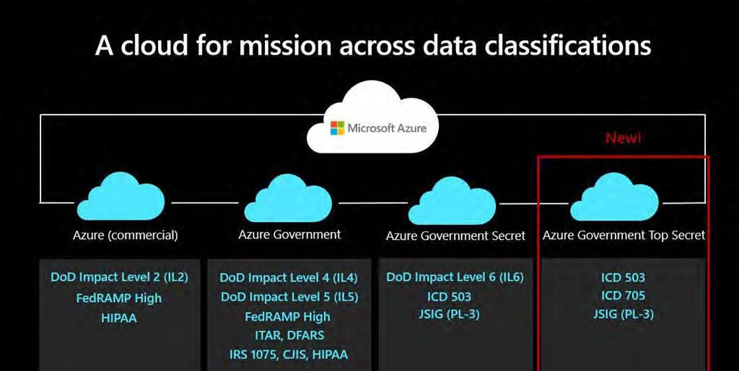

Slide 146
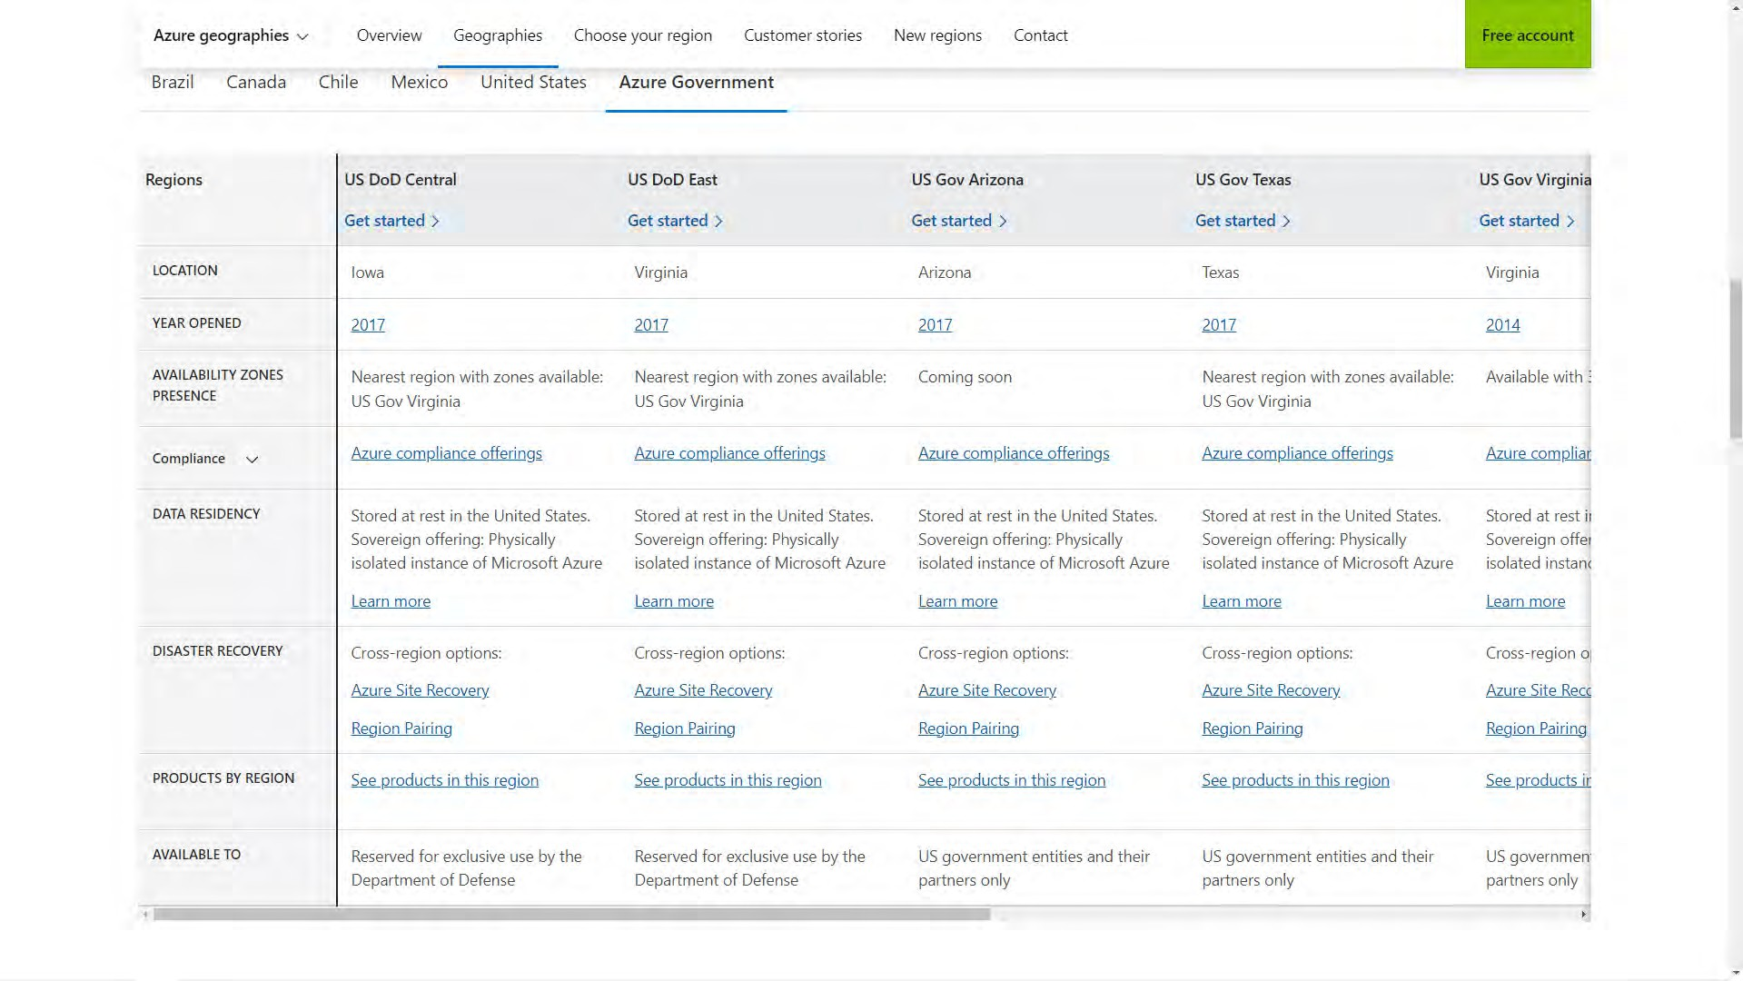

Slide 147
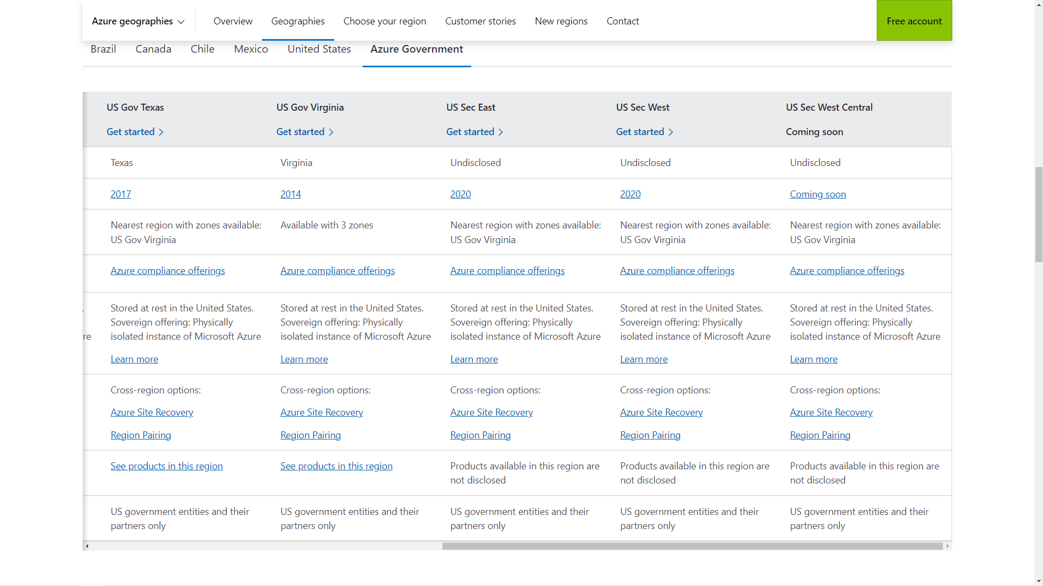

Slide 148
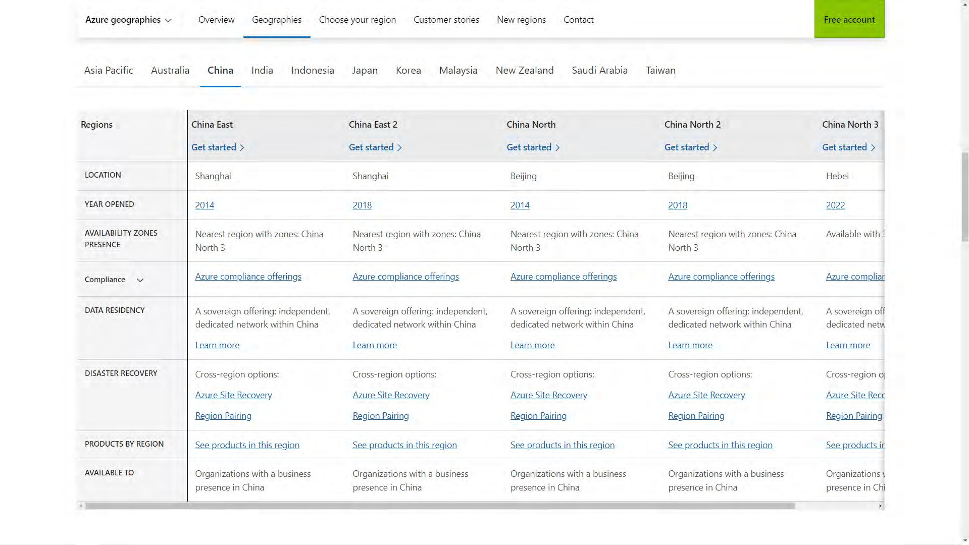

Slide 150
AZ-900
Microsoft Azure Fundamentals
Gopal Das, Instructor
, softwarearchitect.ca… get the course for these slides at: http://sjd.ca/az900

Slide 151
Availability Zones

Slide 152
Azure availability zones are physically separate locations within each Azure region.

Slide 153
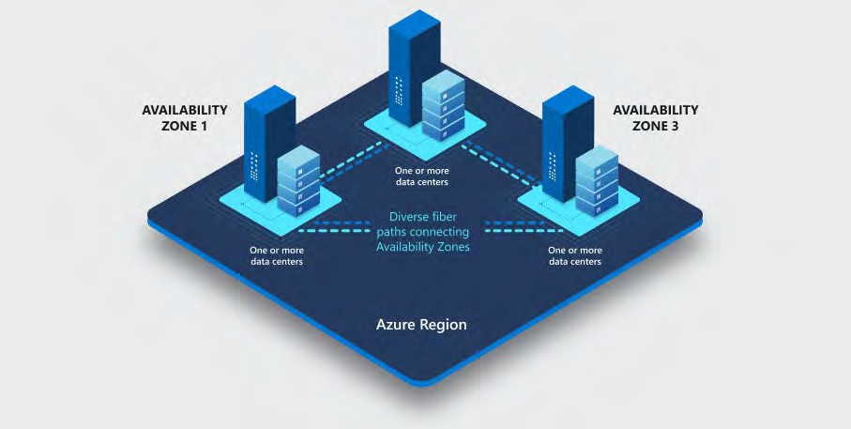

Slide 154

Independent power, cooling, and networking infrastructure

Slide 155
Not every region supports Availability Zones

Slide 156
Regions with Availability Zones
The Americas Brazil South Canada Central
Central US - East US - East US 2
South Central US - West US 2 - West US 3
US Gov Virginia
Europe
France Central Germany West Central
North Europe - West Europe Norway East
UK South
Sweden Central Switzerland North

Slide 157
Regions with Availability Zones
Middle East
Qatar Central
UAE North
Africa
South Africa North
Asia Pacific Australia East Central India Japan East Korea Central
Southeast Asia - East Asia China North 3

Slide 158
Not every service supports Availability Zones

Slide 159
Three Types of AZ Services
Zonal Services
Zone-Redundant Services
Always Available Services

Slide 160
Zonal Services
You can choose a specific Availability Zone to deploy the service to
You then should deploy a duplicate service to another zone to achieve resiliency
E.g. Virtual Machines

Slide 161
Zone-Redundant Services
Automatically deployed across zones for you
You don’t have to configure it
E.g. Azure SQL Database

Slide 162
Always Available Services
These are global services and Microsoft takes care of the ensuring that they are always on
Also called “Non-regional services”
E.g. Azure Portal, Azure Active Directory, Azure Front Door

Slide 163

Some services give you the choice between zonal and zone-redundant

Slide 165
AZ-900
Microsoft Azure Fundamentals
Gopal Das, Instructor
, softwarearchitect.ca… get the course for these slides at: http://sjd.ca/az900

Slide 166
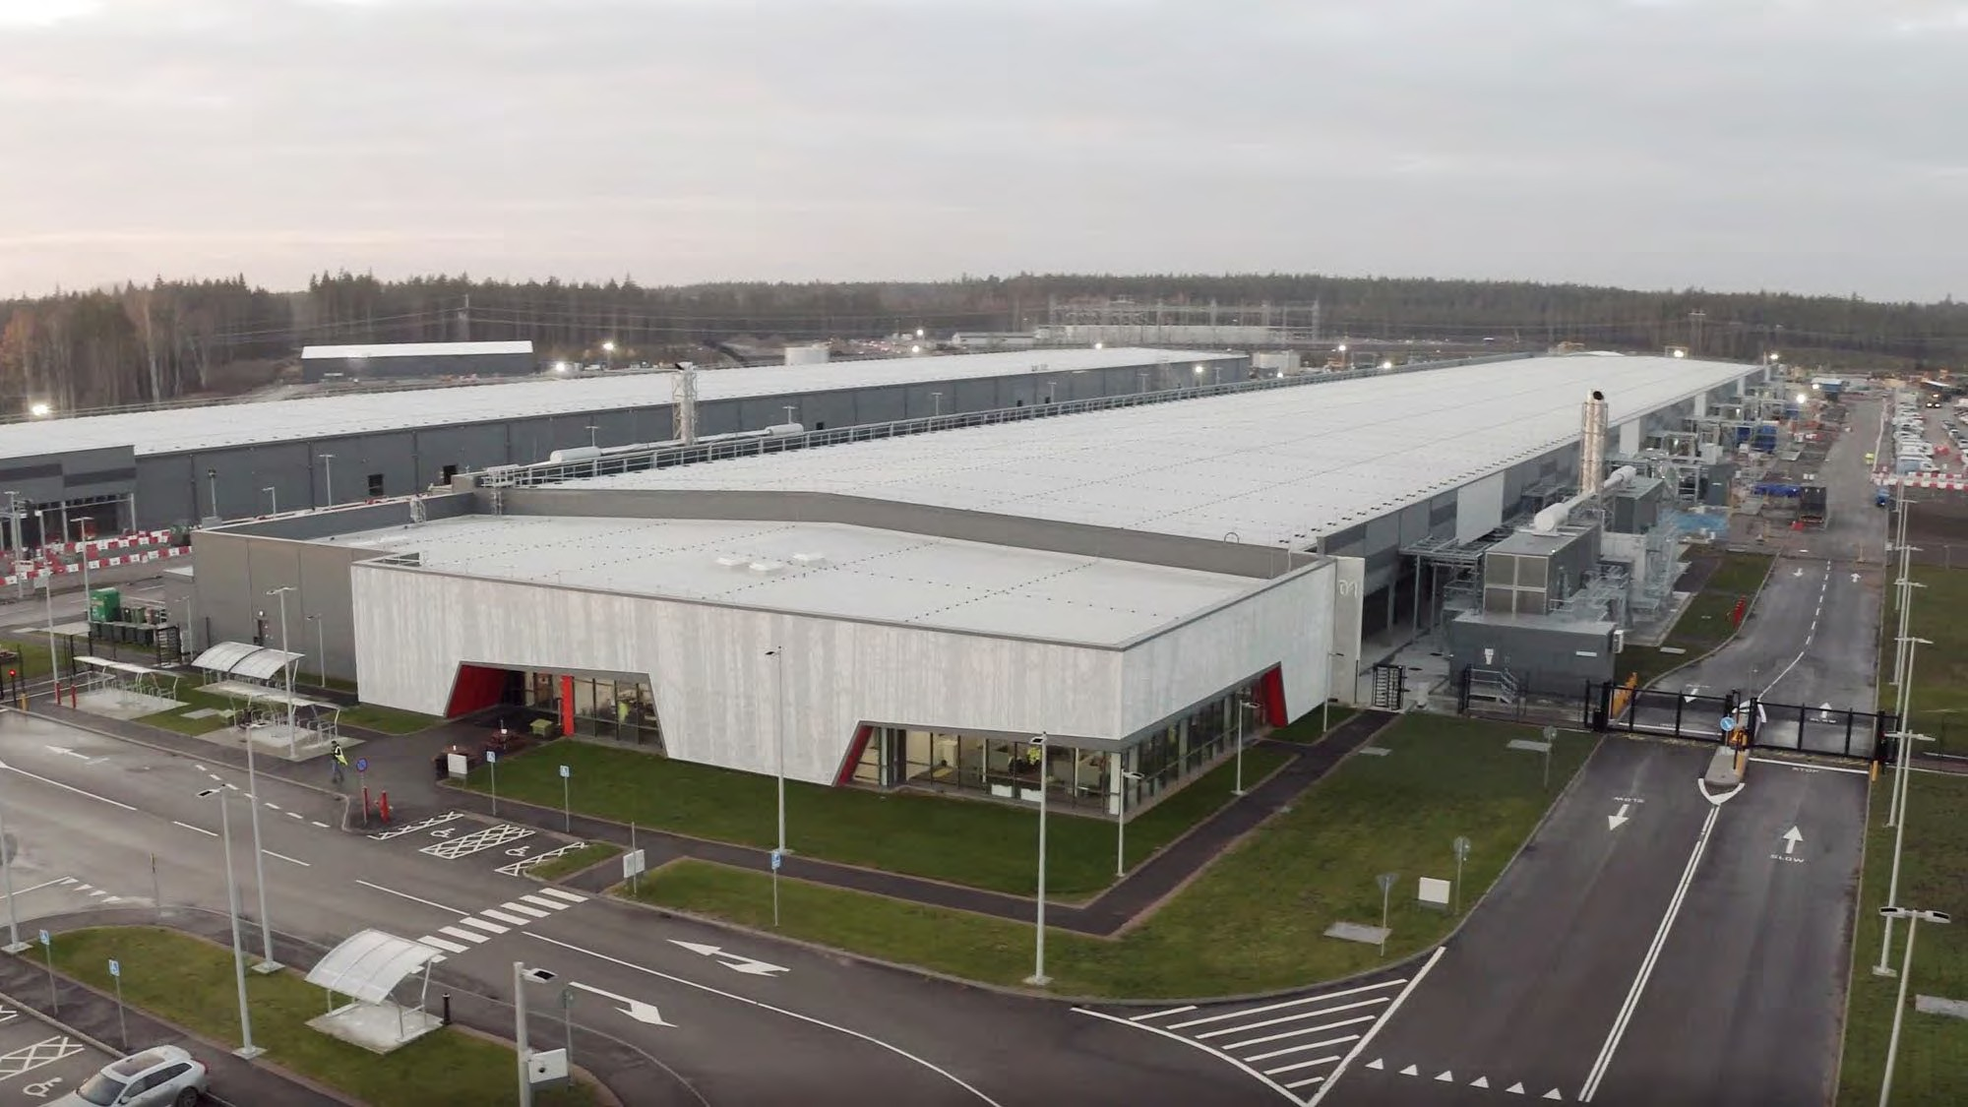
Azure
Data Centers

Slide 168
AZ-900
Microsoft Azure Fundamentals
Gopal Das, Instructor
, softwarearchitect.ca… get the course for these slides at: http://sjd.ca/az900

Slide 169
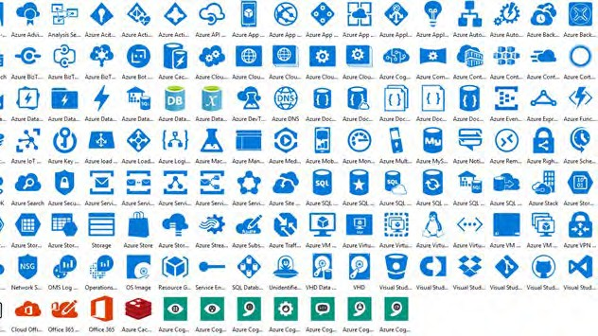
Resources & Resource Groups

Slide 170
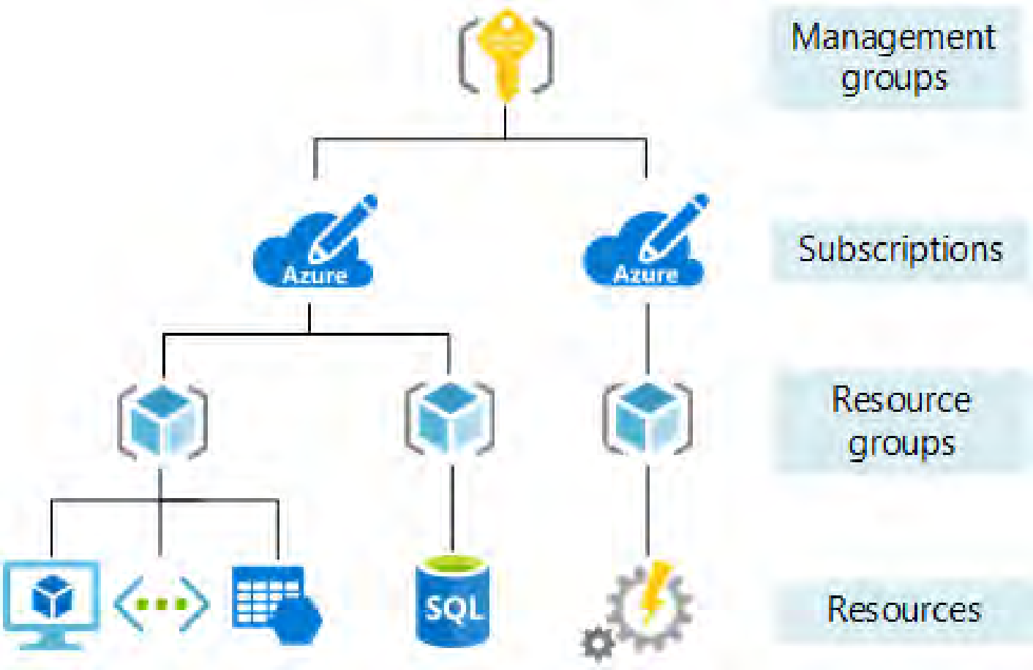

Slide 171
Resources
A generic word to represent an Azure service that you have access to, such as a specific Virtual Machine, Storage Account, or Database
You can create a resource in many different ways – Azure Portal, CLI, PowerShell, ARM Template, etc.

Slide 172
Resources
Each resource has a name created by you
Sometimes it has to be unique, sometimes not
Generally, you indicate the region where they are to be created

Slide 173
All Resources
A brand new subscription is created with no resources
Most resources have costs associated with them
The resource is associated with one (and only one) subscription, to which its cost is billed

Slide 175
Resource Group
A logical grouping of resources
Resource Group associated with a region, which can be different than the resources it contains
All services in a resource group should have a similar lifecycle – deploy together, delete together

Slide 176
Resource & Group
All resources must belong to one and only one resource group
Permissions can be assigned at the resource group level
There is no security boundary offered by a resource group for communications

Slide 178
AZ-900
Microsoft Azure Fundamentals
Gopal Das, Instructor
, softwarearchitect.ca… get the course for these slides at: http://sjd.ca/az900

Slide 179

Subscriptions

Slide 181
Subscriptions
The billing unit within Azure
Always a payment method associated with a subscription
Users can have access to more than one subscription, and different roles

Slide 182
Subscription Plans
Free plan - $200 credits first 30 days
can only have one
Pay as you Go – billed to credit card
Enterprise Agreement – EA
Free credits – MSDN, Startup plans

Slide 183
Multiple Subscriptions
Some companies can choose to have multiple subscriptions
Can be used to separate out business units within an organization – e.g. Sales, IT, Finance
Or separate by geography –
e.g. North America, Europe, Asia

Slide 184
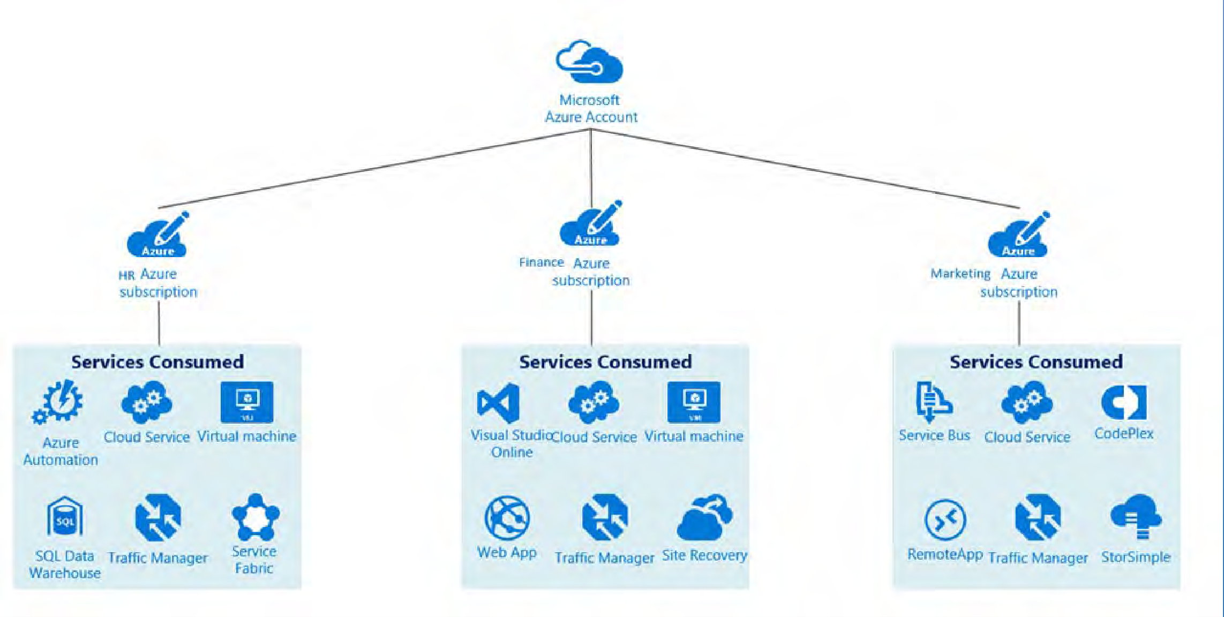

Slide 185
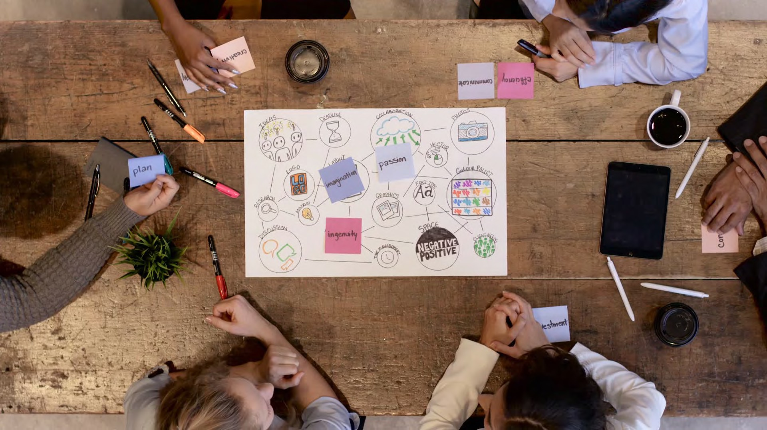
It’s possible to operate an entire organization on a single subscription

Slide 187
AZ-900
Microsoft Azure Fundamentals
Gopal Das, Instructor
, softwarearchitect.ca… get the course for these slides at: http://sjd.ca/az900

Slide 188

Management Groups

Slide 190
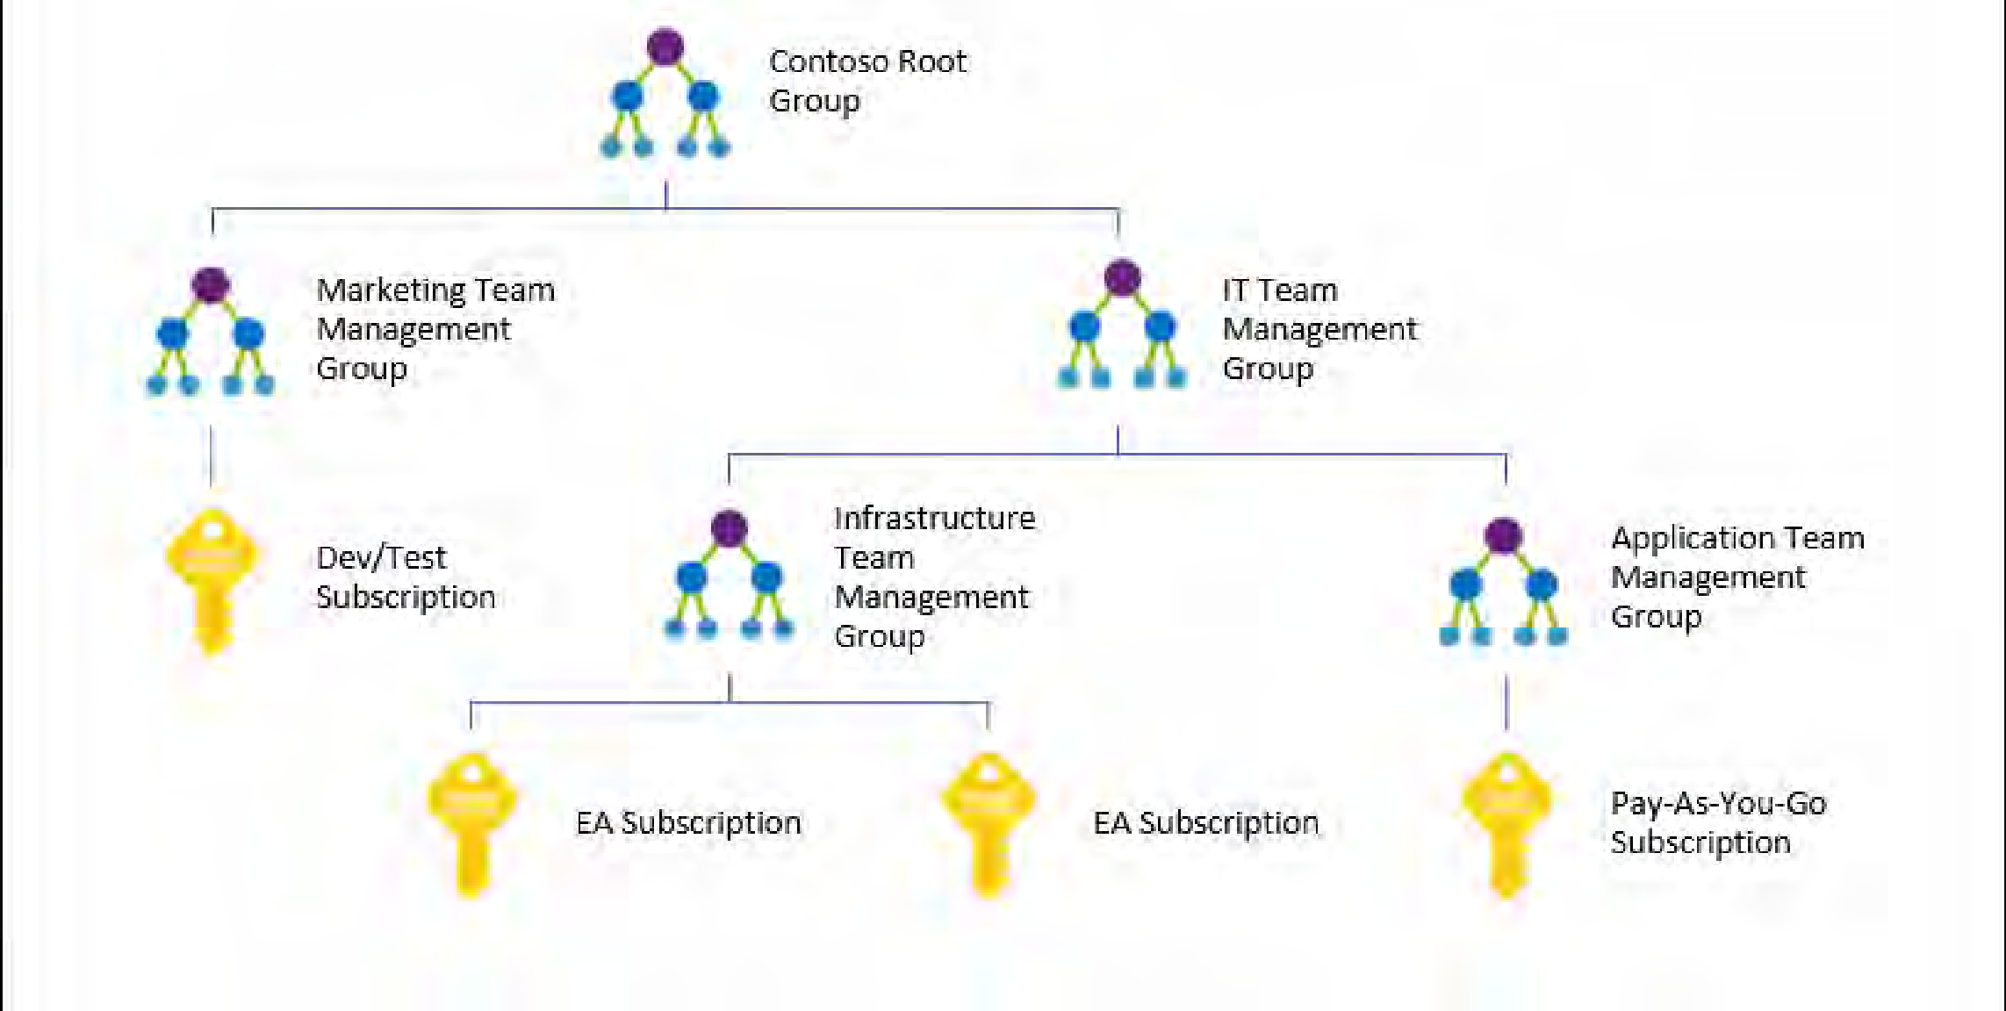

Slide 192
AZ-900
Microsoft Azure Fundamentals
Gopal Das, Instructor
, softwarearchitect.ca… get the course for these slides at: http://sjd.ca/az900

Slide 194
AZ-900
Microsoft Azure Fundamentals
Gopal Das, Instructor
, softwarearchitect.ca… get the course for these slides at: http://sjd.ca/az900

